Slide 1


PYTHON
Lecture 18

Slide 2

Today’s Agenda
Iterative Statements
Types of loop supported by Python
The while loop
The while-else loop
The break , continue and pass Statement

Slide 3
Iterative Statements
There may be a situation when we need to execute a block of code several number of times.
For such situations , Python provides the concept of loop
A loop statement allows us to execute a statement or group of statements multiple times

Slide 4
Iterative Statements
The 2 popular loops provided by Python are:
The while Loop
The for Loop
Recall that Python doesn’t provide any do..while loop like other languages

Slide 5
The while Loop
Syntax:
while condition:
<indented statement 1>
<indented statement 2>
...
<indented statement n>
<non-indented statement 1>
<non-indented statement 2>
Some Important Points:
First the condition is evaluated. If the condition is true then statements in the while block is executed.
After executing statements in the while block the condition is checked again and if it is still true, then the statements inside the while block is executed again.
The statements inside the while block will keep executing until the condition is true.
Each execution of the loop body is known as iteration.
When the condition becomes false loop terminates and program control comes out of the while loop to begin the execution of statement following it.

Slide 6
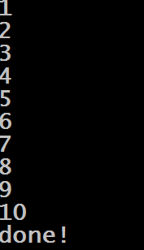
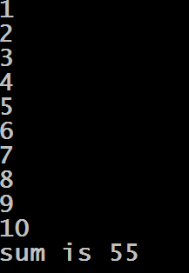
Examples
Example 2:
i=1
total=0
while i<=10:
print(i)
total+=i
i=i+1
print("sum is {0}".format(total))
Output:
Example 1:
i=1
while i<=10:
print(i)
i=i+1
print("done!")
Output:

Slide 7
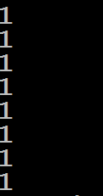
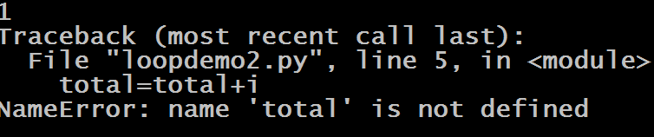
Guess The Output
i=1
while i<=10:
print(i)
total+=i
i=i+1
print("sum is {0}".format(total))
Output:
i=1
while i<=10:
print(i)
i=i+1
print("done!")
Output:

Slide 8
Another Form Of “while” Loop
In Python , just like we have an else with if , similarly we also can have an else part with the while loop.
The statements in the else part are executed, when the condition is not fulfilled anymore.

Slide 9
Another Form Of “while” Loop
Syntax:
while condition:
<indented statement 1>
<indented statement 2>
...
<indented statement n>
else:
<indented statement 1>
<indented statement 2>
Some Important Points:
Many programmer’s have a doubt that If the statements of the additional else part were placed right after the while loop without an else, they would have been executed anyway, wouldn't they.
Then what is the use of else
To understand this , we need to understand the break statement,

Slide 10
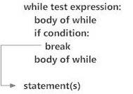
The “break” Statement
Normally a while loop ends only when the test condition in the loop becomes false.
However , with the help of a break statement a while loop can be left prematurely,
Now comes the crucial point:
If a loop is left by break,
the else part is not executed.

Slide 11
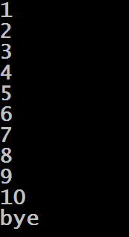
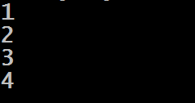
Example
Example 2:
i=1
while i<=10:
print(i)
i=i+1
else:
print("bye")
Output:
Example 1:
i=1
while i<=10:
if(i==5):
break
print(i)
i=i+1
else:
print("bye")
Output:

Slide 12
Exercise
You have to develop a number guessing game. The program will generate a random integer secretly. Now it will ask the user to guess that number . If the user guessed it correctly then the program prints “Congratulations! You guessed it right” .
If the number guessed by the user is larger than the secret number then program should print “Number too large” and , if the number guessed by the user is smaller than the secret number then program should print “Number too small” .
This should continue until the user guesses the number correctly or quits . If the user wants to quit in between he will have to type 0 or negative number

Slide 13
Exercise
You have to develop a number guessing game. Following are the steps needed:
At first , the program will generate a random integer secretly.
Now it will ask the user to guess that number .
If the user guessed it correctly then the program prints “Congratulations! You guessed it right” .
But if the number guessed by the user is larger than the secret number then program should print “Number too large” and , if the number guessed by the user is smaller than the secret number then program should print “Number too small” .
This should continue until the user guesses the number correctly or quits .
If the user wants to quit in between he will have to type 0 or negative number

Slide 14
How To Generate Random Number ?
In Python , we have a module named random .
This module contains a function called randint() , which accepts 2 arguments and returns a random number between them.
import random
a=random.randint(1,20)
print("Random number is",a)
Output:

Slide 15
Solution
import random
secretno=random.randint(1,100)
guess=secretno+1
while guess!=secretno:
guess=int(input("Guess the secret number:"))
if(guess<=0):
print("So Sorry! That you are quitting!")
break;
elif(guess>secretno):
print("Your guess is too large. Try again!")
elif(guess<secretno):
print("Your guess is too small. Try again!")
else:
print("Congratulations! You guessed it right!")

Slide 16
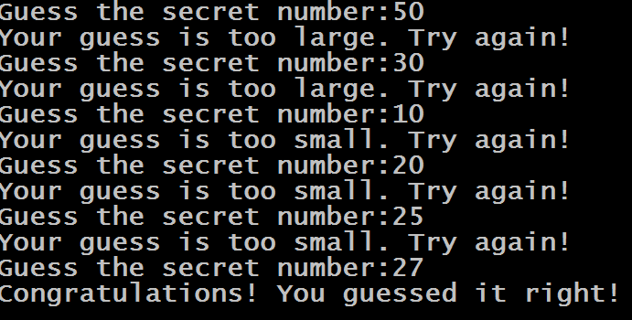
Output

Slide 17
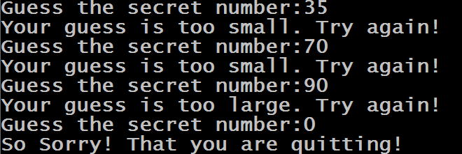
Output

Slide 18
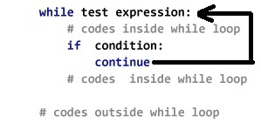
The “continue” Statement
The continue statement in Python returns the control to the beginning of the while loop.
It rejects all the remaining statements in the current iteration of the loop and moves the control back to the top of the loop.

Slide 19
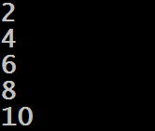
Example
i=0
while i<10:
i=i+1
if(i%2!=0):
continue
print(i)
Output:

Slide 20
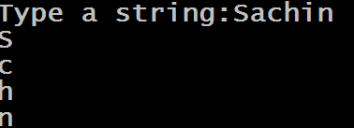
Exercise
Write a program to accept a string from the user and display it vertically but don’t display the vowels in it.
Sample Output:

Slide 21
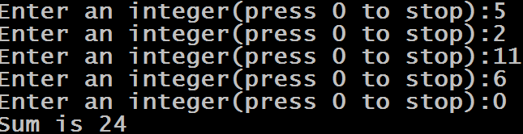
Exercise
Write a program to continuously accept integers from the user until the user types 0 and as soon as 0 is entered display sum of all the nos entered before 0
Sample Output:

Slide 22
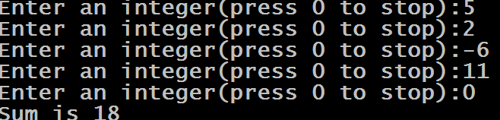
Exercise
Modify the previous code so that if the user inputs negative integer , your program should ignore it .
Sample Output:

Slide 23
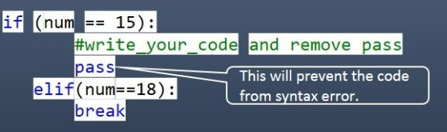
The “pass” Statement
In Python, the pass statement is a no operation statement.
That is , nothing happens when pass statement is executed.
Example:

Slide 24
Example
i=0
while i<10:
i=i+1
if(i%2!=0):
pass
else:
print(i)
Output:

